Slide 1
SRM Institute of Science and Technology Advanced Programming Practice-18CSC207J Unit 5 - Symbolic Programming Paradigm

Slide 2
Topics
Symbolic Maths, algebraic manipulations, limits, differentiation, integration, series
SymPy usage for symbolic maths
Equation Solving, Matrices
Other Lang: Aurora, LISP, Wolfram
Demo: Symbolic Programming in Python

Slide 3
Introduction
Symbolic computation deals with the computation of mathematical objects symbolically. This means that the mathematical objects are represented exactly, not approximately, and mathematical expressions with unevaluated variables are left in symbolic form.
It Covers the following:
As A calculator and symbols
Algebraic Manipulations - Expand and Simplify
Calculus – Limits, Differentiation, Series , Integration
Equation Solving – Matrices

Slide 4
Calculator and Symbols
Rational - ½, or 5/2
>>import sympy as sym
>>a = sym.Rational(1, 2)
>>a Answer will be 1/2
Constants like pi,e
>>sym.pi**2 Answer is pi**2
>>sym.pi.evalf() Answer is 3.14159265358979
>> (sym.pi + sym.exp(1)).evalf() Answer is 5.85987448204884
X AND Y
>> x = sym.Symbol('x')
>>y = sym.Symbol('y')
>>x + y + x – y Answer is 2*x

Slide 5
Algebraic Manipulations
EXPAND ( X+Y)**3 = X+3X^2Y+3XY^2+Y
>> sym.expand((x + y) ** 3) Answer is x**3 + 3*x**2*y + 3*x*y**2 + y**3
>> 3 * x * y ** 2 + 3 * y * x ** 2 + x ** 3 + y ** 3 Answer is x**3 + 3*x**2*y + 3*x*y**2 + y**3
WITH TRIGNOMETRY LIKE SIN,COSINE
eg. COS(X+Y)= - SIN(X)*SIN(Y)+COS(X)*COS(Y)
>> sym.expand(sym.cos(x + y), trig=True) Answer is -sin(x)*sin(y) + cos(x)*cos(y)
SIMPLIFY
(X+X*Y/X)=Y+1
>>sym.simplify((x + x * y) / x) Answer is: y+1

Slide 6
Calculus
LIMITS compute the limit of
limit(function, variable, point)
limit( sin(x)/x , x, 0) =1
Differentiation
diff(func,var) eg diff(sin(x),x)=cos(x)
diff(func,var,n) eg
Series
series(expr,var)
series(cos(x),x) = 1-x/2+x/24+o(x)
Integration
Integrate(expr,var)
Integrate(sin(x),x) = -cos(x)

Slide 7
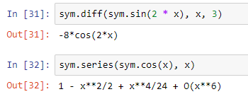
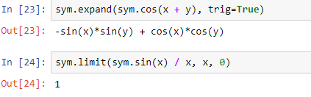
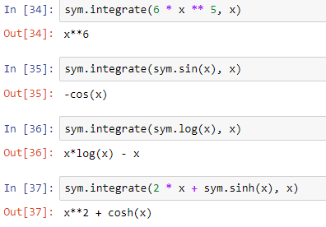
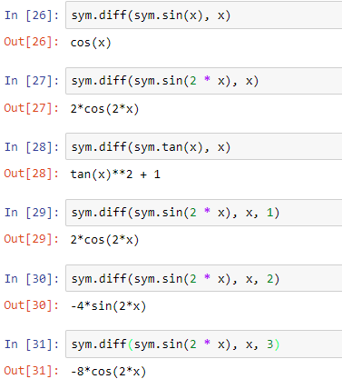
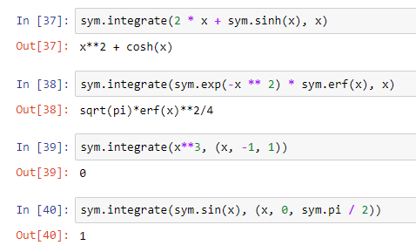
Example
Example:

Slide 8
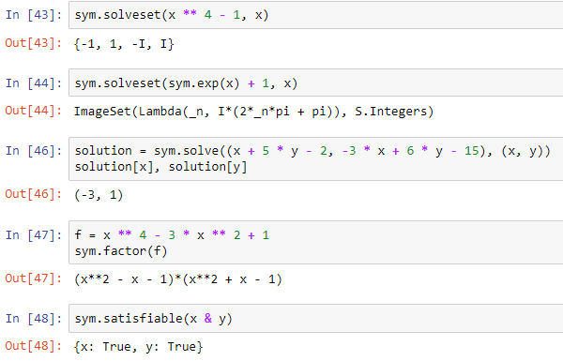
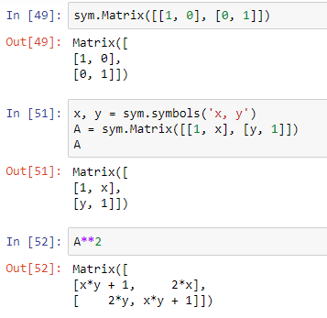
Example
Example:

Slide 9
Equation Solving
solveset()
solveset(x ** 4 - 1, x) ={-1,1,-I,I}
Matrices
A={[1,2][2,1]} find A**2

